Slide 1

Your business success starts with Email Marketing

Slide 2


Why iDreamBiz
We at iDreamBiz Visualize our team to be acknowledged as the e-Transformers who are committed to deliver the highest quality Web Solutions and Services, bringing in altogether new dimensions to the online existence and business for their clients.
www.iDreamBiz.com

Slide 3
SOME FACTS ABOUT EMAIL MARKETING
For every $1 spent, $44.25 is the average return on email marketing investment. Email marketing has an ROI of 4,300%
95% of online consumers use email.
The Radicati Group forecasts the email audience will grow from 2.42 billion this year to 2.76 billion by 2017.
94% of businesses use email while only 61% of them use social media.
www.iDreamBiz.com

Slide 4
Are You REALLY Doing It RIGHT?
Do You KNOW?
43% of all emails are now being opened via a mobile device&69% of mobile users delete emails that aren't optimized for mobile. Are you sending responsive emails?
33% of email recipients open email based on subject line alone & Subject lines fewer than 10 characters long had an open rate of 58%.Does your subject lines really stand out in inboxes?
Suppressing anyone in your list who hasn't engaged with your emails in over a year increases your deliverability rate by 3-5% immediately. Have you ever considered cleaning your email list?
Spam filters work on a point system and hates sloppy codes. Does your developer test email newsletter?
www.iDreamBiz.com

Slide 5
BENEFITS OF USING EMAIL MARKETING
1
Maximizing Your Marketing ROI
2
Increasing Customer Profitability
3
Driving More Sales Conversions
Email marketing is 20 times more cost-effective than traditional media. It's six to 12 times less expensive to sell to an existing customer than to a new one.
Email is an easy and inexpensive way of establishing early and long-lasting relationships. Award VIP’s with free coupon and referral reward. Building relationship is a key.
Gently nurture a prospect through the sales process, provide important data and drive the prospect to your Website. Campaign response generally occurs within 48 hours.
4
Targeted Global Reach
5
Improving Tracking & Feedback
Segment email list based on customer’s behavior based on their purchase history or actions. Globally reach to targeted audience who are really interested in your product & services.
Most types of marketing and advertising are difficult to measure but with email, everything can be tracked. Get valuable feedback as you strive to grow your business.
www.iDreamBiz.com

Slide 6


What is REALLY Working in 2015
DRIP CAMPAIGNS
ENGAGE EMAIL MARKETING
In 2015, Drip Campaigns are really playing an important role in nurturing leads and converting it to sales. People love to see your stuff before ordering your services this is where Drip Marketing comes in.
Engage Email Marketing is an another way to stay in touch with your audience. Businesses are sharing regular contents with their subscribers like blogs, webinars, events etc. in order to engage them with their product and services.
www.iDreamBiz.com

Slide 7


What is REALLY Working in 2015
ECOMMERCE MARKETING
VIDEO EMAILS
eCommerce portals gradually shifting to behavior based email campaigns. They track who abandoned cart in their store, what visitors are searching for, reselling products after last purchase, product review etc.
Use of Video within emails. Video plays a vital role when it comes to delivering information in most effective manner. These days Businesses using Video as a most favorable tool for building trust.
www.iDreamBiz.com

Slide 8
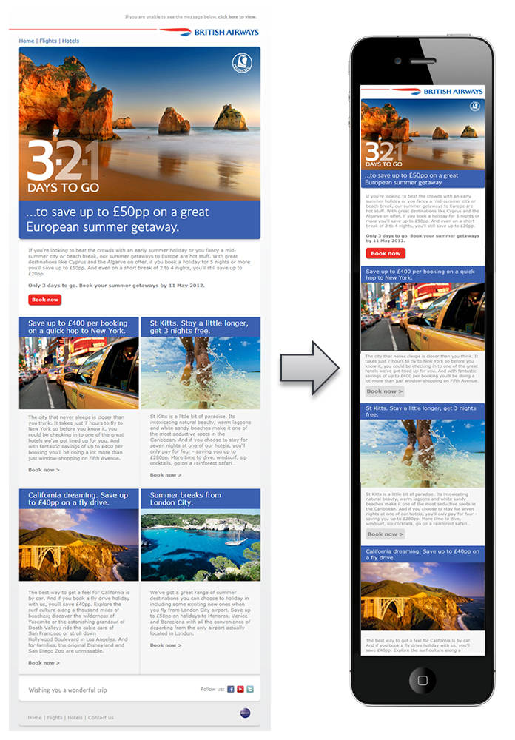
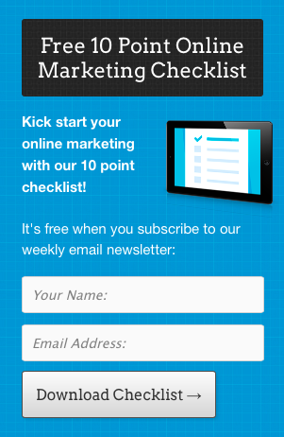
What is REALLY Working in 2015
RESPONSIVE EMAILS
POP-UP FORMS
As you already know, 43% emails open on mobile these days so sending responsive email is a another key to maximize email ROI.
Trend of using of pop forms to increase the subscriber base. It’s really helping online stores in building list for future sales and comparably website bounce rate has been drop down tremendously.
www.iDreamBiz.com

Slide 9





Email Campaign Management
A New Form of Email Marketing
CALENDAR PLANNING
3rd PARTY INTEGRATIONS
The frequency, and occasion of delivery of your emails make a huge importance to the open rates of emails and consequently, your revenue growth.
Businesses around the world use applications suited to their needs, and hence there are numerous CRMs. We help you integrate them with email marketing.
MARKETING AUTOMATION
LIST MANAGEMENT
Customers at every stage of the lifecycle behave differently, and demand a different care, and so should our emails.
We help you organize or segment your email list into categories relevant to your requirements.
TEMPLATE DESIGNING
REPORT & ANALYSIS
Plain text emails don’t work anymore. We design emails riddled with images and rich text to compel customers to buy or click through.
We design, send and measure how many emails made to your customer’s inbox. A full report on how customers responded to your emails.
www.iDreamBiz.com

Slide 10
iDreamBiz WORKING PROCESS
First, we will understand your business model, traffic and current email marketing campaigns.
SCREENING
DEVELOPMENT
REPORTING
EXECUTION
MARKETING PLAN
After screening process, we will come up basic email marketing plan depending upon your budget.
Upon Approval, our team will develop Web Forms, Integrations, email newsletters etc.
Our marketing managers will execute campaigns as per marketing plan.
We will share reports with our feedback.
www.iDreamBiz.com

Slide 11
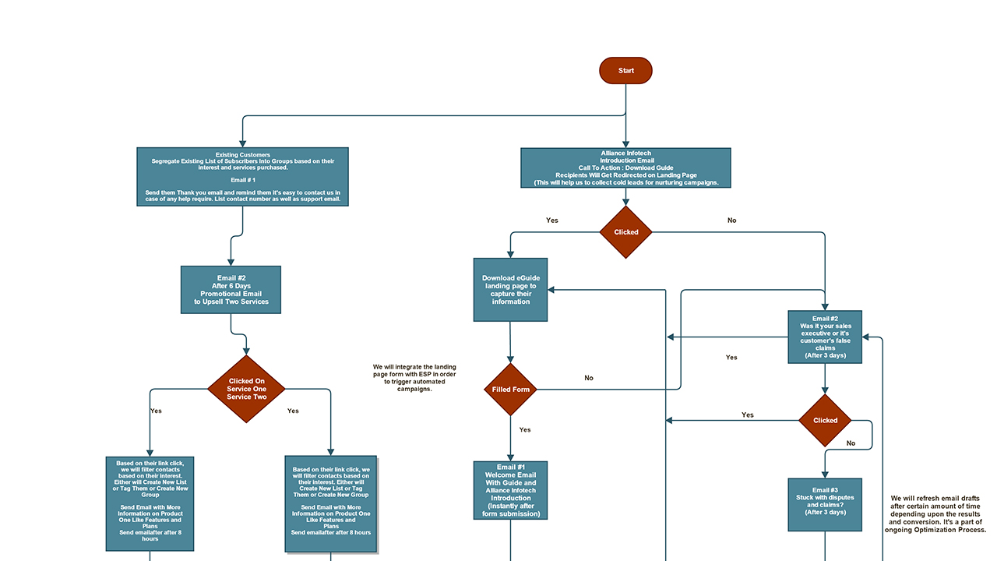
Email Marketing Workflow at iDreamBiz

Slide 12
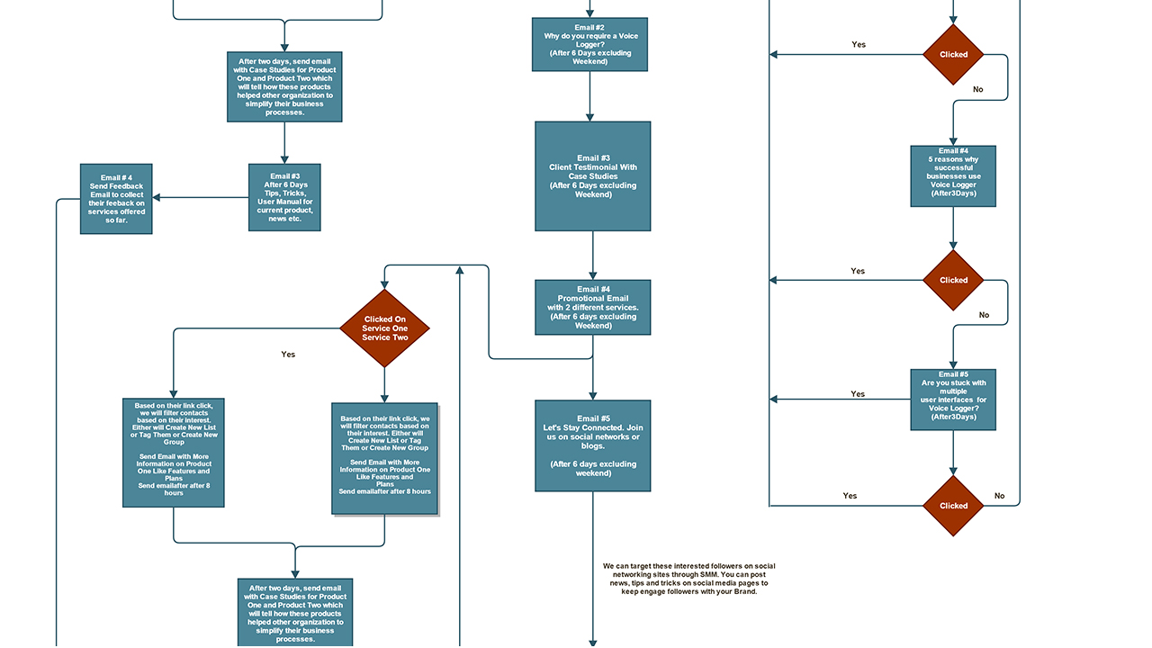

Slide 13
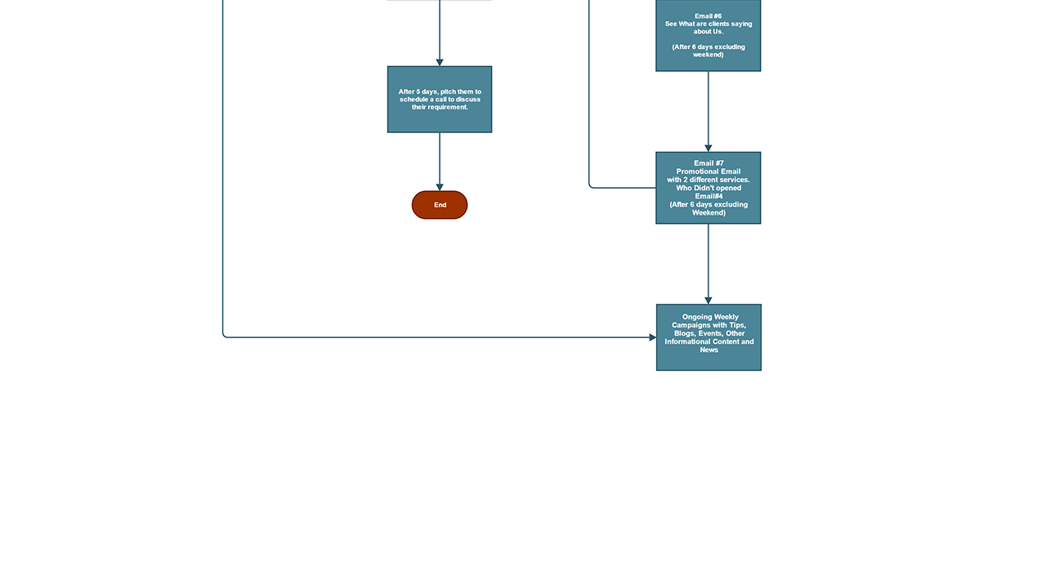
Presented here is a snippet of how we execute our email marketing campaigns.

Slide 14
How iDreamBiz Can HELP You With Your Email Marketing Tasks
Our template experts will design, code & test email newsletter prior to schedule.
Custom integrations for behavior based campaigns.
Customize Web Forms and Drip Campaigns.
Ongoing optimization for higher conversion.
Email List & Campaign Management.
Customize reporting & analysis.
www.iDreamBiz.com

Slide 15


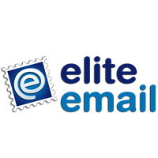

























EMAIL PLATFORMS WE WORK ON
www.iDreamBiz.com

Slide 16
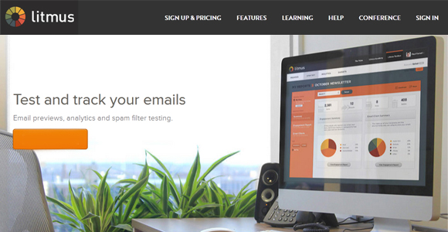
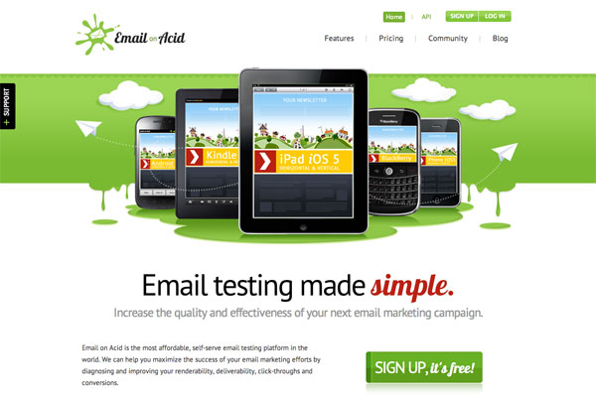
How We Assure Quality Services
Test, Test & Test is the key to assure quality services in Email Marketing . We use tools like Litmus or EmailOnAcid to test your email campaigns before they reach to your customers. We split test various designs to ensure maximum conversion and ROI.
LITMUS
Litmus is a simple, web-based application that is the perfect complement to VerticalResponse, MailChimp, or any other mailing tool you’re using. Litmus is the email marketer’s secret weapon for bulletproof campaigns.
EmailOnAcid
Email On Acid is a self-serve email testing platform that aims to help users email marketing campaigns through targeting and improving render ability, deliverability, and click-through.
www.iDreamBiz.com

Slide 17





What Our CLIENTS Say About Us
Simon, Xtralights.com
So far these guys are doing an amazing job for my Email marketing. While our SEO is doing trash, our Email marketing is actually doing so well that we don't even need SEO anymore! Their service is generating wonderful ROI than any other marketing channels now.
Parag Patel, Foresight
I can't say how wonderful it was to work with this team. We needed what seemed like endless adjustments due to our misunderstanding of technology. These guys not once lost patience but quickly strove to explain what could be and could not be done.
Tech Mahindra
Work was done very well, on time with good communication. We like the ability to track and improve success rates with accurate metrics.
Bike2Power
Working with iDreamBiz has been fantastic. The quality of work produced has been outstanding. Great communication and quick turn around. They are very efficient meeting all expectations upon delivering the project on time with a great results.
Investors Clinic
We have used iDreamBiz several times and they are responsive and provide high quality HTML designs that meet our needs. Highly recommend.
www.iDreamBiz.com

Slide 18










Some of Our Clients
www.iDreamBiz.com

Slide 19


OFFICE LOCATION
India
G-275, 3rd Floor, Sec-63, Noida - 201301
0120- 4115530
info@idreambiz.com
www.iDreamBiz.com

Slide 20
THANKS FOR WATCHING
www.iDreamBiz.com

